Slide 1

British Airways Reviews Analysis
Visualizations and Metrics.

Slide 2
Data Understanding
This data was scraped from a website called Skytrax and it contains reviews from 2017 to 2024, a period of 8 years. The data consists of 8 columns and 3731 rows.
The columns are: Title , Author, Location, Date, Review, Rating, Type Of Traveller; Seat Type, Route, Date Flown, Recommended and Aircraft.

Slide 3
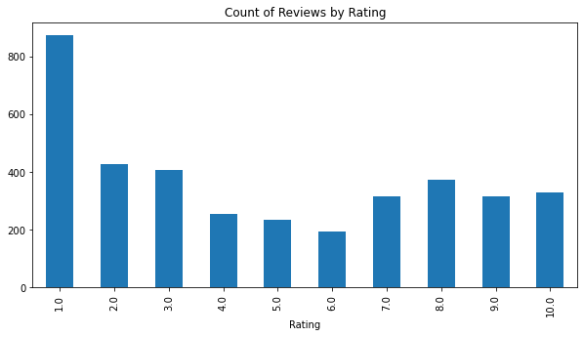
EDA
By using all the reviews, the ratings were quite low with more than 800 users giving the experience a 1 out of the possible 10.

Slide 4
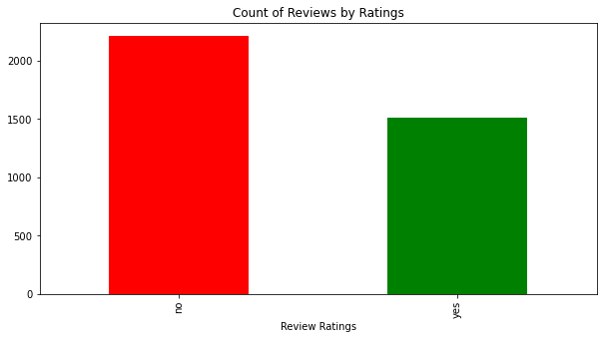
EDA
Out of all the users only 40% would recommend the airline to others.

Slide 5
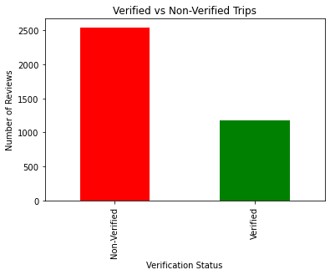
EDA
For more accurate data, the dataset was split and data from only verified trips was considered in the analysis.

Slide 6
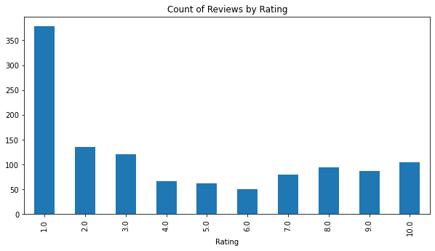
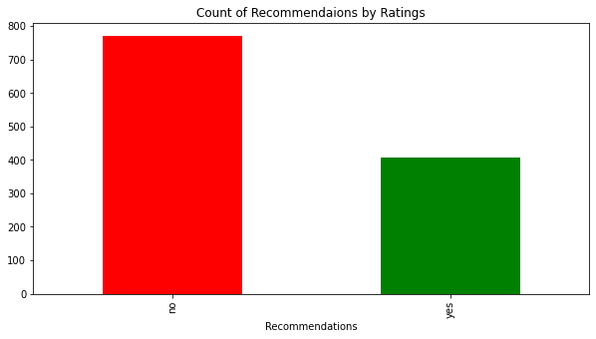
EDA
After the already set precedent, analysis was done to only to verified trips and the ratings and recommendations were also low.

Slide 7
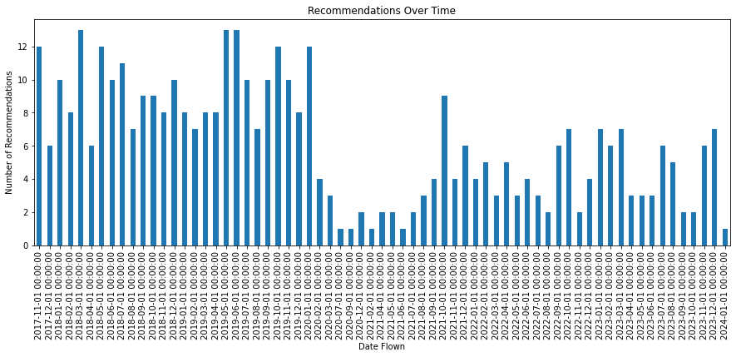
EDA
The number of recommendation decreased over time mostly owing to the COVID - 19 Pandemic and less data collected which suggests that service delivery is more or less the same.

Slide 8
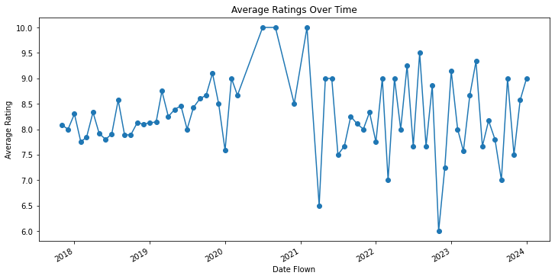
EDA
The average rating over time shows a
more or less stagnant rating before 2020 and the average is then affected by the industry as it recovers as shown by data collected in the next slide.

Slide 9
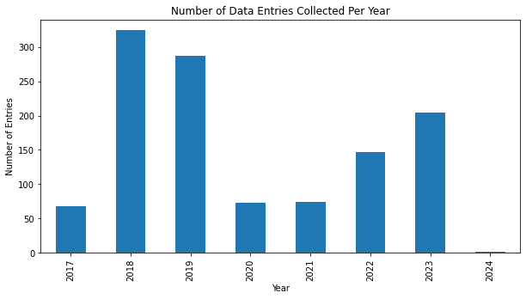
EDA
The slowly increasing review from 2020 is attributed to the industry slowly recovering from the effects of COVID-19.

Slide 10
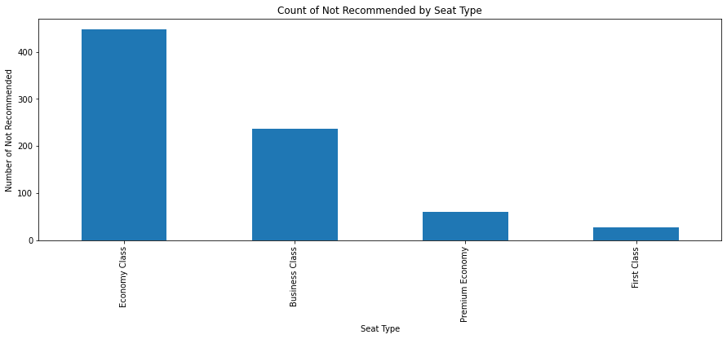
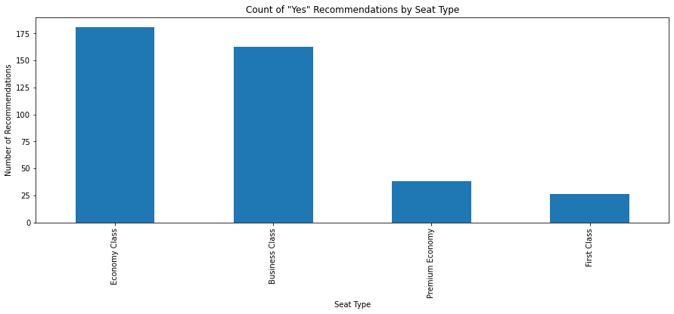
EDA - Recommendations by seat type
The economy class has the most amount of entries as the carrier carry more passengers is that class and the recommenders are way less than the non recommenders.

Slide 11
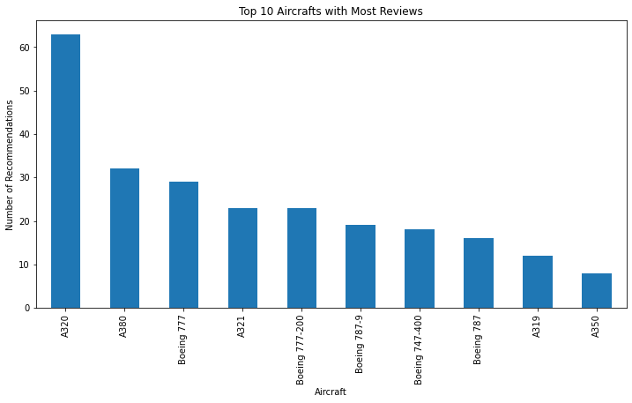
EDA
The Airbus A320 has the most reviews considering BA flies a fleet of more than 40 of them it is expected.

Slide 12
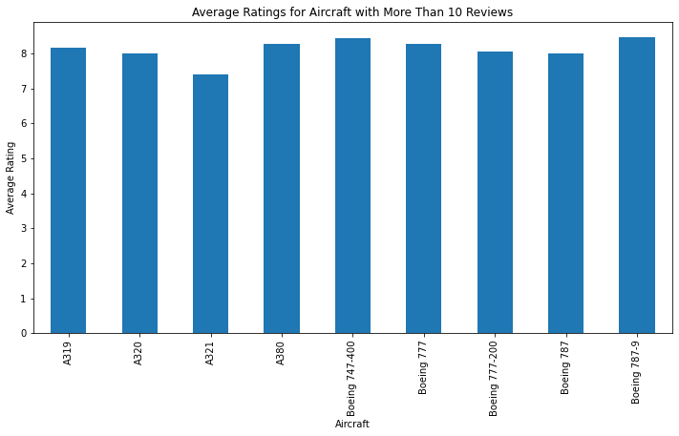
EDA
This plot shows the
average rating of the top 10 aircrafts and the Boeing 787-9 tops them all. Though the Boeing 747’s were grounded they come a close second.

Slide 13
34%
Recommendations are low for the airline. Shows a huge number of customers are dissatisfied with the services offered by BA.

Slide 14
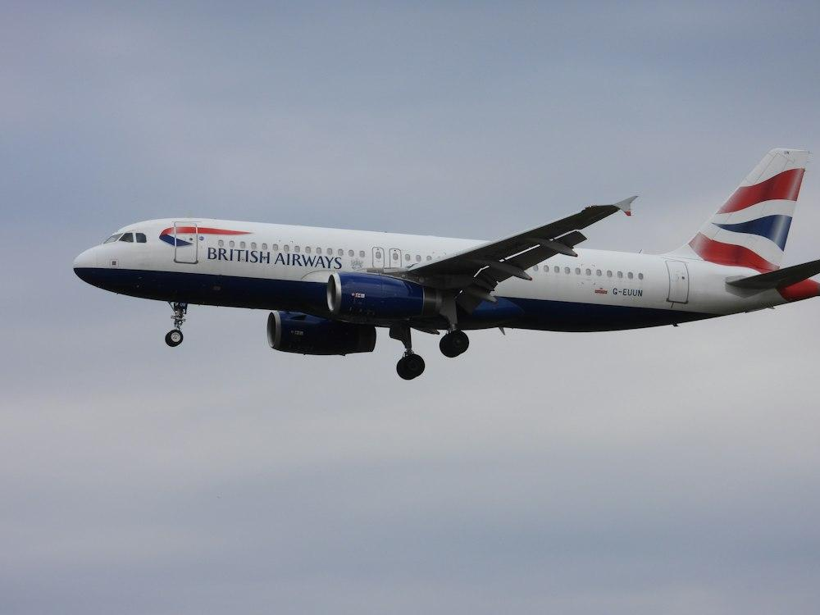

Data Scrapped and Analyzed by Agape Gichuki.

